Slide 1
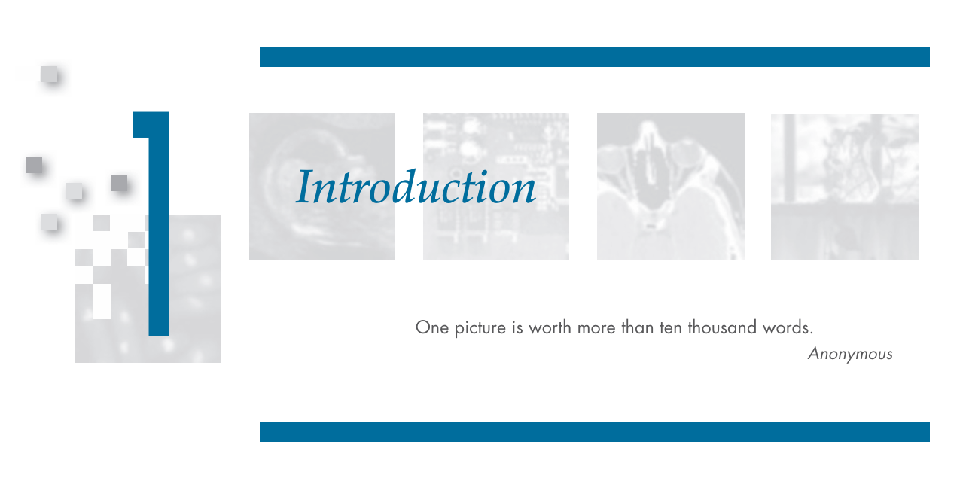

Slide 2
What is digital image processing ?
An image may be defined as a two-dimensional function, f(x, y), where x and y are spatial (plane) coordinates, and the amplitude of f at any pair of coordinates (x, y) is called the intensity or gray level of the image at that point. When x, y, and the intensity values of f are all finite, discrete quantities, we call the image a digital image.
The field of digital image processing refers to processing digital images by means of a digital computer. Note that a digital image is composed of a finite number of elements, each of which has a particular location and value. These elements are called picture elements, image elements, pels, and pixels. Pixel is the term used most widely to denote the elements of a digital image.

